Slide 1
Lecture 2 Describing and Visualizing Distributions

Slide 2
Review: Data, Observations and Variables
What are data?
Data are a collection of observations or measurements – the values recorded on one or more variables. Data may be structured (fixed rows and columns) or unstructured (free text, images, audio).
What is an observation?
A single unit, individual, or case on which measurements are recorded – one store, one skull, one penguin.
What is a variable?
A characteristic that is measured or recorded on every observation, and whose value can differ from one observation to the next.
In a data table: each row is an observation and each column is a variable.

Slide 3
Review: Types of Variables
For each scenario: what is the variable being recorded, and what type of variable is it?
1. A researcher interested in pinniped morphology measures the whisker length of 9 harbor seals to the nearest tenth of a millimeter.
Variable: whisker length (mm) – quantitative, continuous
2. For each of 40 animals admitted to a marine mammal rehabilitation center, the attending veterinarian records the species: harbor seal, California sea lion, or northern elephant seal.
Variable: species – qualitative, nominal
3. At each of 15 haul-out sites along the coast, a field team counts the number of pups present.
Variable: number of pups at a site – quantitative, discrete
4. Every admitted animal is also given a body condition score of poor, fair, good, or excellent by the attending veterinarian.
Variable: body condition score – qualitative, ordinal

Slide 4
Where We Left Off
Last class we said:
A statistic is a numerical characteristic of data used to describe a property of a population: a collection of persons, objects, or things.
That definition leans on the word population – but we never said what one actually is.
And we can rarely measure an entire population. So where do the numbers in a statistic actually come from, and what can they tell us about the population we never fully see?
Up next: populations, samples, and sampling.

Slide 5
Sampling and Data
Statistics is generally concerned with studying properties of a population – the collection of all possible persons, events, or objects of interest
e.g the set of all possible observations – observed + unobserved
Populations can be real and finite (e.g. all employees at a company) or hypothetical and unlimited (e.g. every hand that could ever be dealt in poker – a process we can repeat indefinitely)
A Sample is a subset of the population that we actually observe – the observed observations
The idea of Sampling is to select a portion or individuals or objects that are representative of the population
By studying the sample we can gain insights about the population
Population
Sample

Slide 6
A Note on notation:
Since statistical science is a mathematical discipline, we have a notation that we commonly use:
Fun fact: Leonhard Euler introduced sigma notation in the 18th century. Euler began using the Greek capital letter sigma, Σ, to denote summation, apparently because S is the first letter of summa (Latin for “sum”).

Slide 7
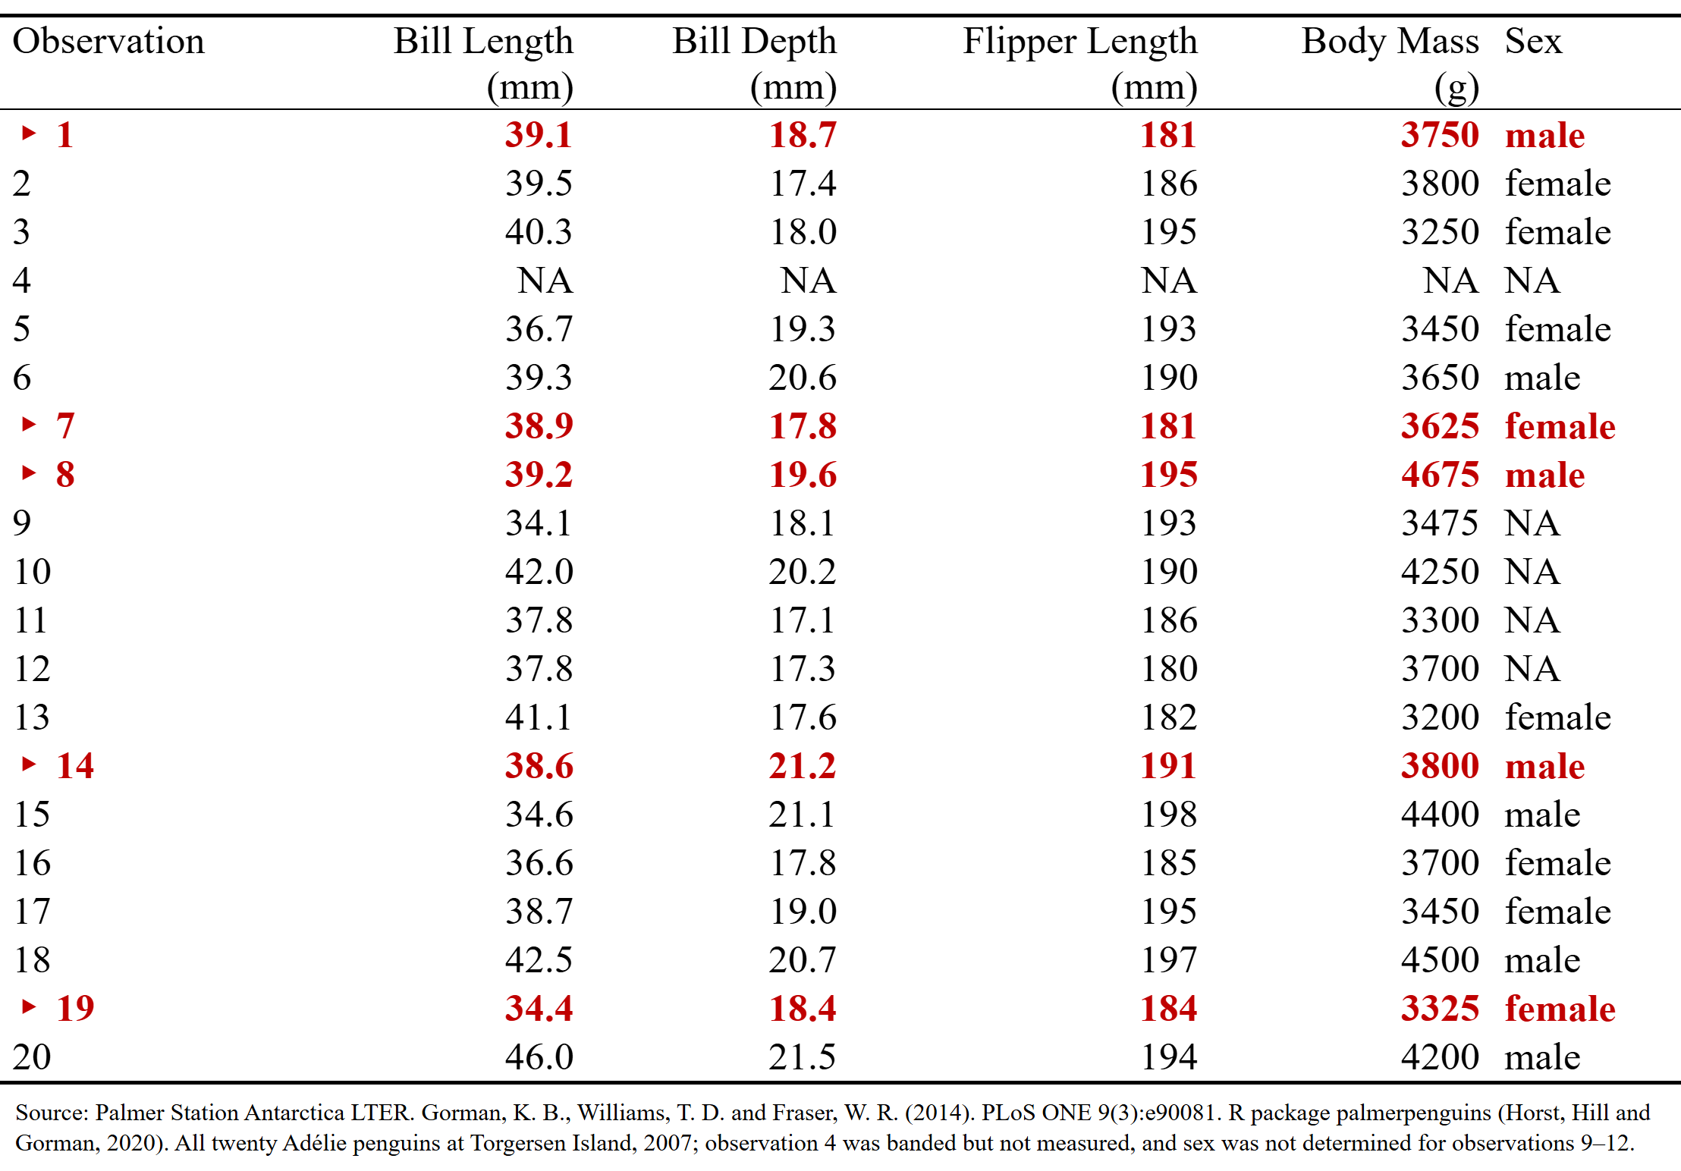
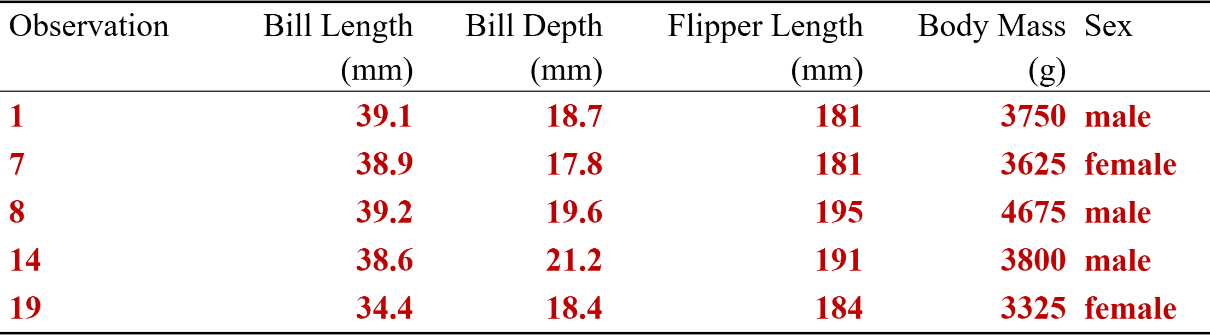
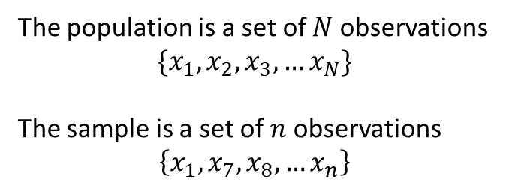
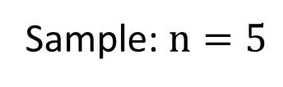
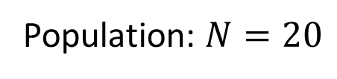
Example: Penguins at Torgersen Island
The population is a set of $N$ observations
$$\{x_{1}, x_{2},x_{3},…x_{N}\}$$
The sample is a set of $n$ observations
$$\left\{x_{1},x_{7},x_{8},x_{14},x_{19}\right\}$$
Population: $N=20$
Sample: $n=5$

Slide 8
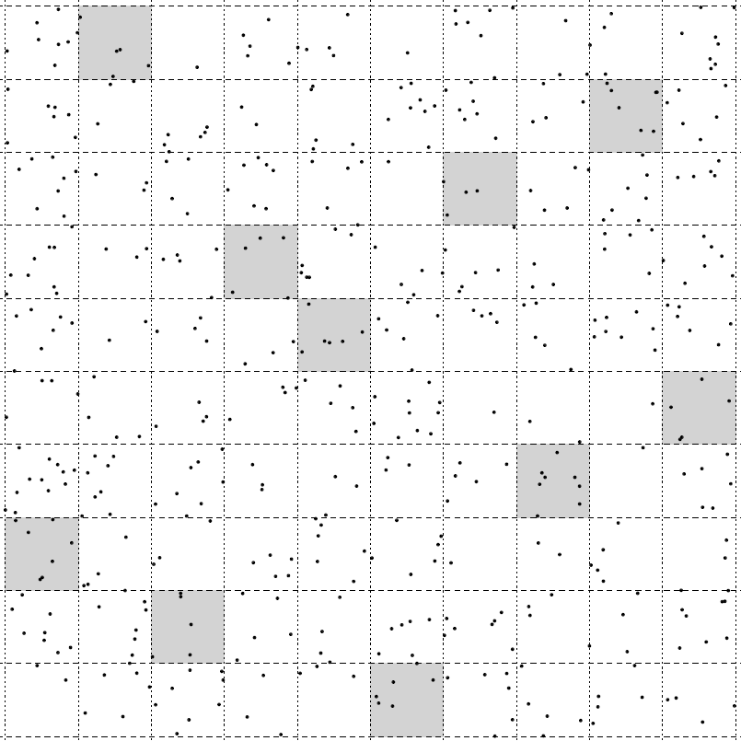
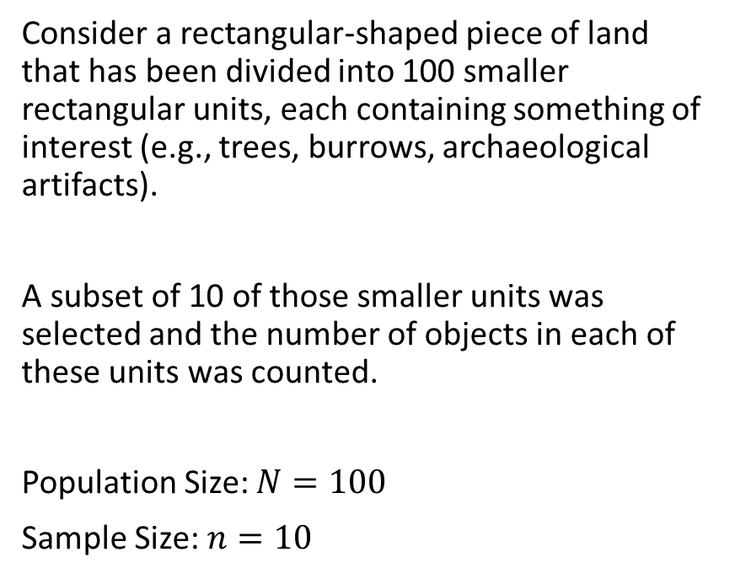
Example 2
Consider a rectangular-shaped piece of land that has been divided into 100 smaller rectangular units, each containing something of interest (e.g., trees, burrows, archaeological artifacts).
A subset of 10 of those smaller units was selected and the number of objects in each of these units was counted.
Population Size: $N=100$
Sample Size: $n=10$

Slide 9
Why is statistics so valuable?
As we said at the start: most of the time we can’t measure everyone or every unit in the population, and so we must limit our measurements to a sample.
A central task in statistics is estimation – the process of inferring an unknown quantity about a population using a set of sample data.
The tools for estimation let us approximate almost anything about a population using only a well-chosen sample.
And they tell us how far off we are likely to be – which is what separates an estimate from a guess.

Slide 10
Where we can go with estimates
With estimates we can
Assess differences among groups and relationships between variables.
Describe populations. Examples of estimates include averages, proportions, measures of variation, and measures of relationship.
Then we can ask and answer questions or formally, test and evaluate hypotheses.

Slide 11




Statistics Vs Parameters
A statistic is a numerical characteristic of a sample that estimates a population parameter.
A parameter is a numerical characteristic of a population that can be estimated by a statistic.
Put another way…
A statistic is a function of the observations of in a sample while a parameter is a function of all observations in the population.
Sample
Statistic
estimate
7.8
$$n$$
Population
Parameter
Value
8.2
$$N$$

Slide 12
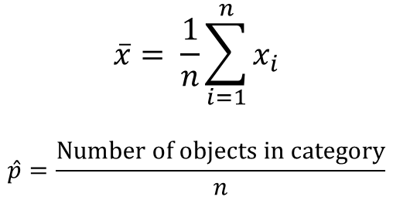
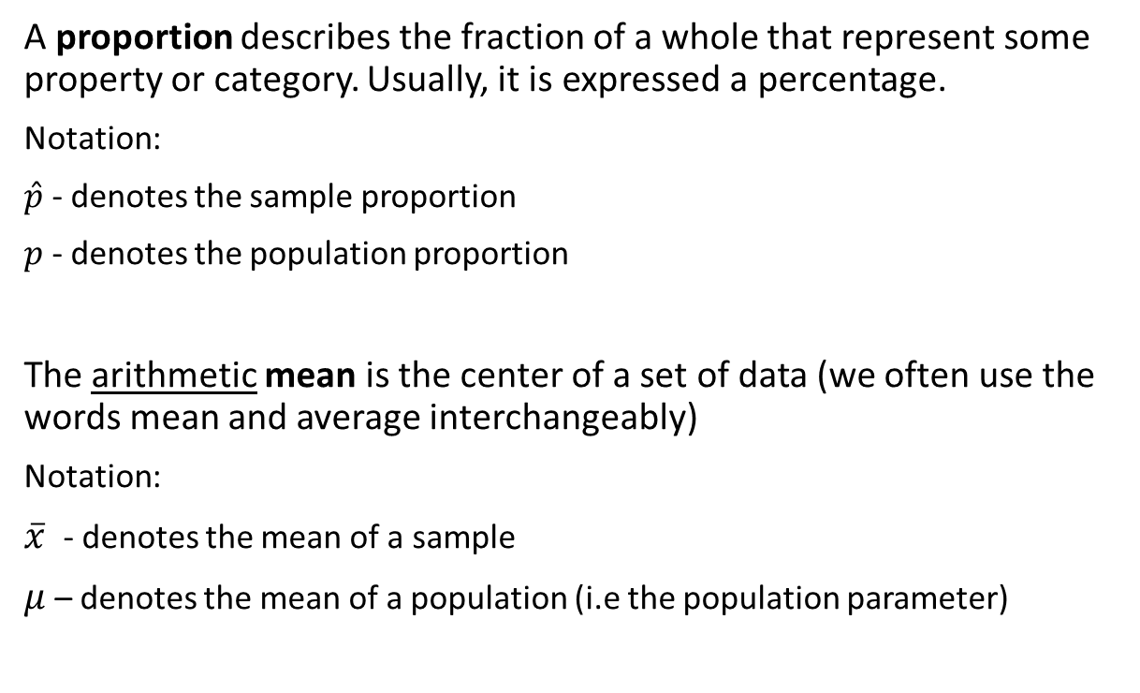
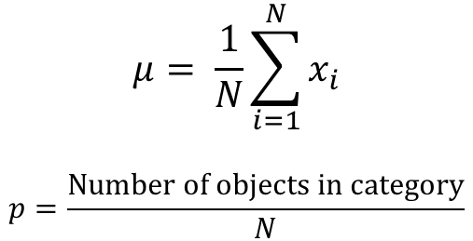
Mean and Proportion
Parameter
$$μ= \frac{1}{N}\sum_{i=1}^{N}{x_{i}}$$
$$p=\frac{Number of objects in category}{N}$$
A proportion describes the fraction of a whole that represent some property or category. Usually, it is expressed a percentage.
Notation:
$\hat{p}$ - denotes the sample proportion
$p$ - denotes the population proportion
The arithmetic mean is the center of a set of data (we often use the words mean and average interchangeably)
Notation:
$\overline{x}$ - denotes the mean of a sample
$μ$ – denotes the mean of a population (i.e the population parameter)
Statistic
$$\overline{x}= \frac{1}{n}\sum_{i=1}^{n}{x_{i}}$$
$$\hat{p}=\frac{Number of objects in category}{n}$$

Slide 13

Example: Gallup Poll
On April 20, 2010, one of the worst environmental disasters took place in the Gulf of Mexico when the Deepwater Horizon offshore oil rig exploded.
In response to the spill, many activists called for an end to offshore drilling. Almost nine months later, turbulence in the Middle East pushed the price of oil to an all-time high.
In March 2011, Gallup conducted a survey and found that 60% of Americans favored offshore drilling as a means to reduce U.S. dependence on foreign oil.
The poll interviewed 1,021 adults aged 18 and older in the continental U.S., selected by random digit dialing.
What is the population, and what parameter is being estimated?
All adults 18 and older in the continental U.S.; the parameter is p, the true proportion of them who favor offshore drilling.
What is the sample, and what is the statistic?
The 1,021 adults interviewed (n = 1,021); the statistic is p̂ = 0.60.

Slide 14
Descriptive Vs. Inferential Statistics
Design – The process/method in which we plan to collect data to answer our statistical question
Descriptive Statistics – refers to describing the observations in a sample using statistics or a population using parameters
- collection, organization, summarization and visualization of data
Inferential Statistics (or statistical inference) – refers to using a sample (usually a statistic) to answer a question about a population (such as estimating the value of a parameter)
- estimation, hypothesis testing, determining relationships among variables, prediction

Slide 15
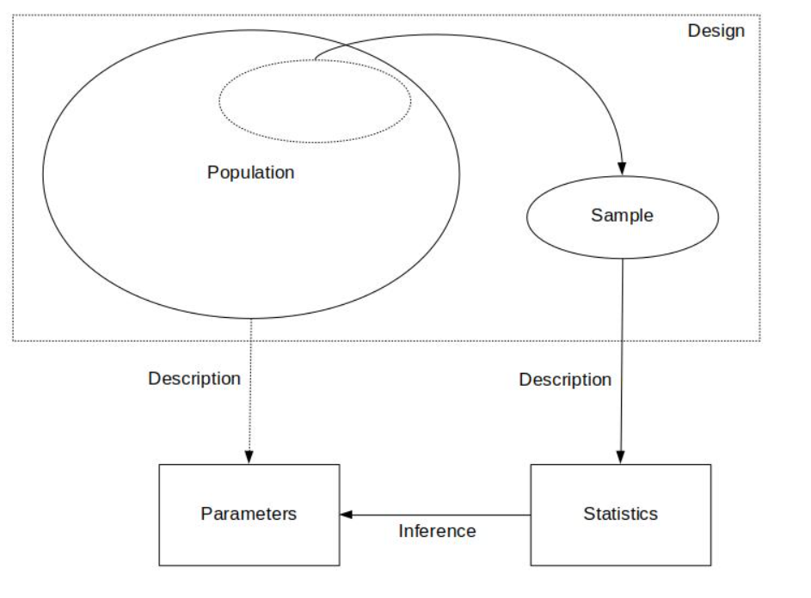
The Big Picture

Slide 16
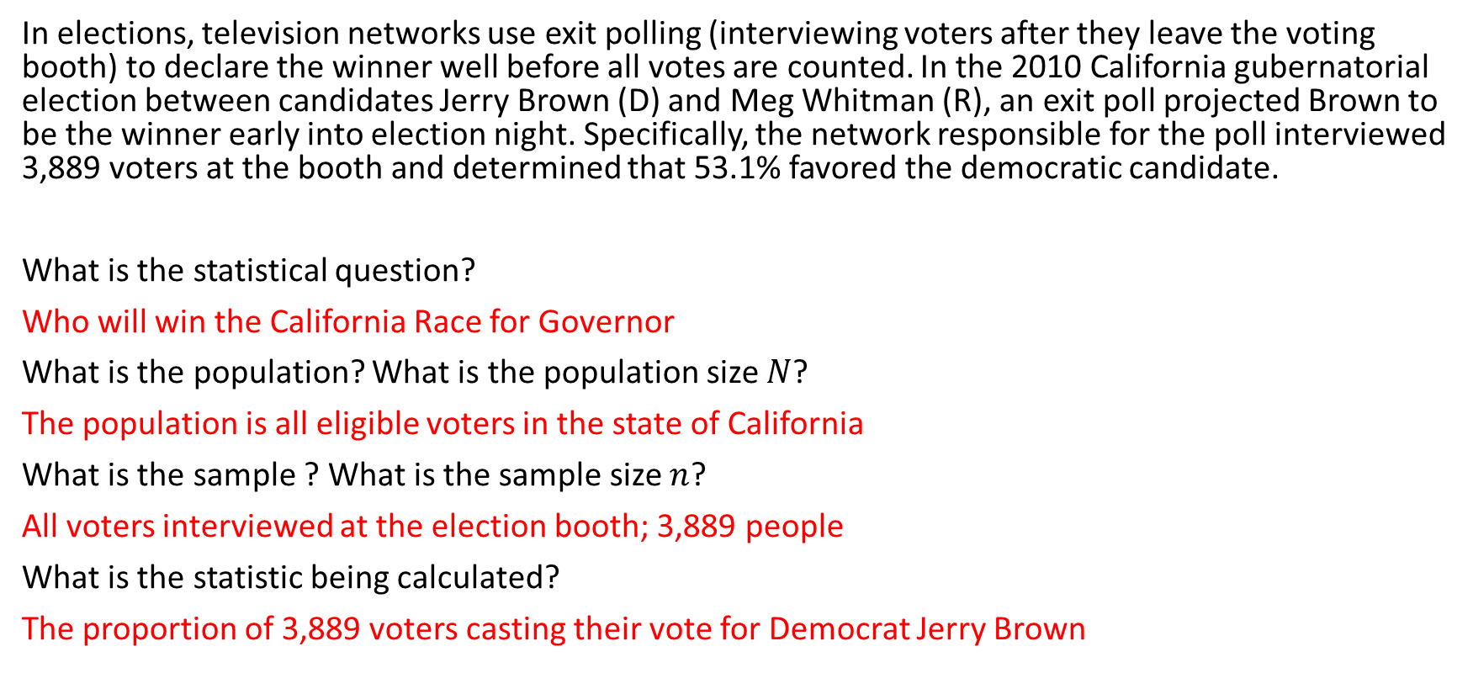
Warm Up
In elections, television networks use exit polling (interviewing voters after they leave the voting booth) to declare the winner well before all votes are counted. In the 2010 California gubernatorial election between candidates Jerry Brown (D) and Meg Whitman (R), an exit poll projected Brown to be the winner early into election night. Specifically, the network responsible for the poll interviewed 3,889 voters at the booth and determined that 53.1% favored the democratic candidate.
What is the statistical question?
Who will win the California race for governor?
What is the population? What is the population size $N$?
All Californians who actually voted – not everyone eligible. N is unknown that night.
What is the sample? What is the sample size $n$?
The 3,889 voters interviewed as they left the booth; n = 3,889.
What is the statistic being calculated?
p̂ = 0.531, the proportion of those 3,889 who chose Brown.

Slide 17
Recap:
Design – the goal/statistical question we want to answer and how we plan to obtain our data
Description – a preliminary exploration and summary of the data
Inference – using statistics to make decisions or predictions about the data

Slide 18
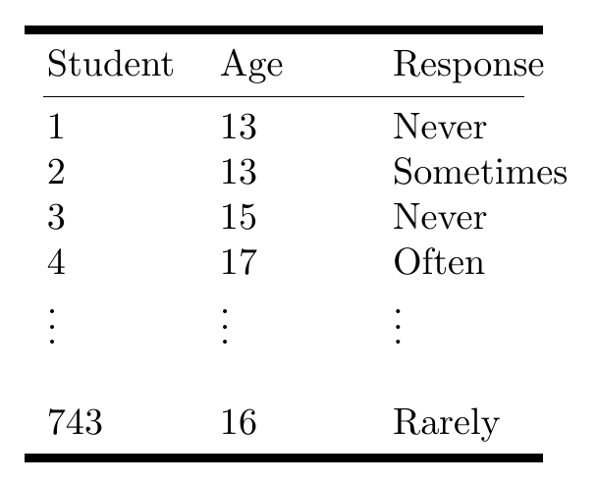
Descriptive statistics
Ex. Are teens distracted by their cell phones? A study conducted by the Pew Research center surveyed 743 U.S teenagers ages 13-17 to understand how cell phones in class impacted their ability to concentrate. Each student was asked to rate the impact of cell phone use on their concentration based on a Likert scale
Methods for summarizing, visualizing and characterizing data
The data can be from samples OR populations
Goal: simplify the data without distorting or losing information
Summaries are easier to understand
Possible Responses: Never, Rarely, Sometimes, Often

Slide 19
